Slide 1
TRIGONOMETRY

Slide 2
Trigonometric Ratio
Figure 1 is a right-angled triangle.
Look at the angle β,
a is the adjacent side,
b is the opposite side and
c is the hypotenuse.
Pythagoras’ theorem: c² = a² + b²
c
Figure 1
b
β
a

Slide 3






Trigonometric Ratio (cont)
Based on the angle β, the six trigonometric functions namely sine, cosine, tangent, secant, cosecant and cotangent which have the following trigonometric ratio:
c
b
β
a

Slide 4
Trigonometric Ratio (cont)
Example 1:The diagram shows ABC has right-angle at B such that the sides AB=3, BC=4 and AC=5. Find the six trigonometric ration at the angle θ.
A
5
3
θ
B
C
4

Slide 5
Trigonometric Ratio (cont)
Example 2: Find, correct to two decimal places the length of the side AB and BC of the diagram below.
A
9.327 cm
73.2ᵒ
B
C

Slide 6
Trigonometric Ratio (cont)
Example 3: From the diagram below, find, correct to 2 decimal places, the length of BC and the length of CD
A
21.52cm
53.2ᵒ
31.5ᵒ
B
D
C

Slide 7


Trigonometric ratio for angles: 30ᵒ, 45ᵒ and 60ᵒ
C
Consider an equilateral triangle ABC with sides of 2 units length.
Trigo ratio of 30ᵒ :
Trigo ratio of 60ᵒ:
30ᵒ
30ᵒ
2
2
60ᵒ
60ᵒ
B
A
1
D
1

Slide 8

Trigonometric ratio for angles: 30ᵒ, 45ᵒ and 60ᵒ (cont)
Consider an isoceles triangle ABC. The two sides AB and BC are of 1 unit length.
Trigo ratio of 45ᵒ :
C
45ᵒ
1
45ᵒ
B
A
1

Slide 9
Trigonometric ratio for angles: 30ᵒ, 45ᵒ and 60ᵒ (cont)
The following table summarizes the trigonometric ratio for the angles 30ᵒ, 45ᵒ and 60ᵒ.
 | 30ᵒ | 45ᵒ | 60ᵒ
sin θ
cos θ
tan θ |  | 1

Slide 10
Trigonometric ratio for angles: 30ᵒ, 45ᵒ and 60ᵒ (cont)
Example 4: Without using calculator, evaluate the following. Leave your answers in terms of surds when necessary.
sin30ᵒ + cos60ᵒ
sin60ᵒ . cos30ᵒ
sin45ᵒ/ tan45ᵒ
Sin 45ᵒ + cos 45ᵒ
cos0ᵒ +sin90ᵒ – tan60ᵒ

Slide 11
The Sign of trigonometric Ratio of any angle in four quadrants of a Cartesian Plane
y
2nd Quadrant
sine (+ve)
cosine (-ve)
tangent (-ve)
1st Quadrant
sine (+ve)
cosine (+ve)
tangent (+ve)
0
x
3rd Quadrant
sine (-ve)
cosine (-ve)
tangent (+ve)
4th Quadrant
sine (-ve)
cosine (+ve)
tangent (-ve)
Mnemonic: A S T C (Are School Tests Crazy?)

Slide 12
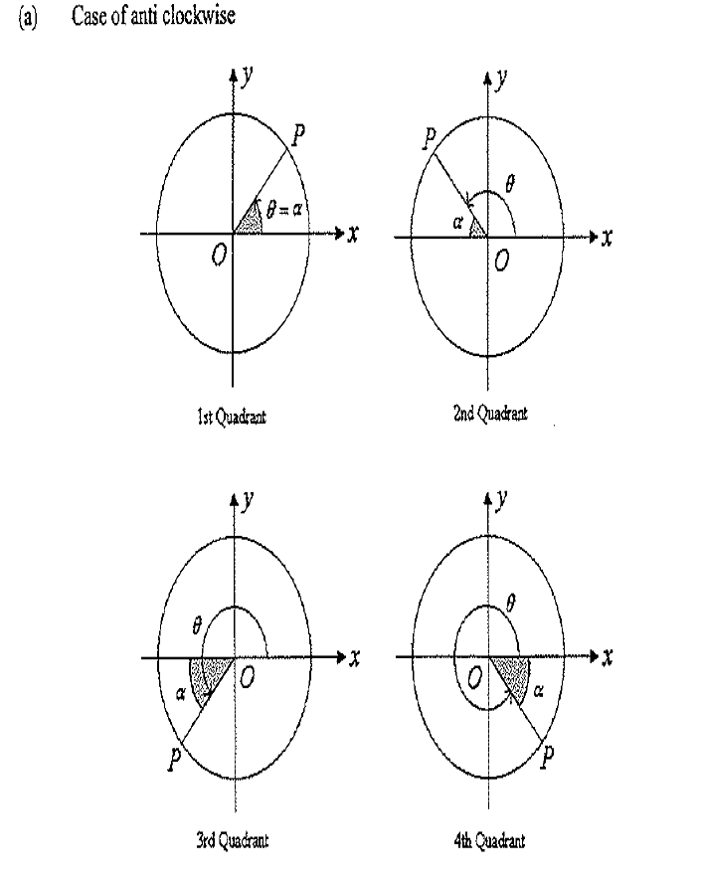
Reference Angle
The magnitude of acute angle,α is called the reference angle, where it is always formed between the rotating ray OP and the x-axis.

Slide 13
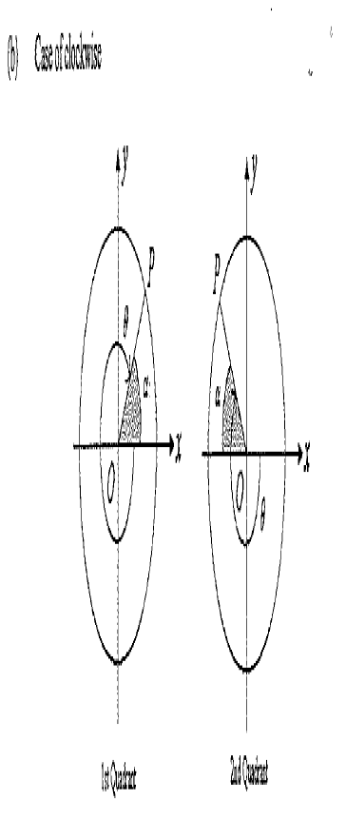
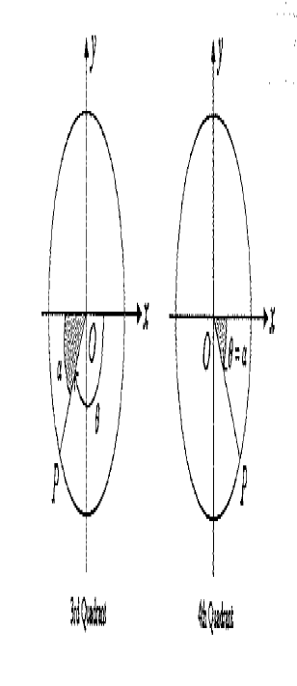
Reference Angle (cont)

Slide 14
Reference Angle (cont)
Example 5: Without using a calculator, evaluate the following.
cos 315ᵒ
cot (-300ᵒ)
Example 6: If sin 70ᵒ≈ 47/50, find the approximation values of the following without using a calculator.
sin 430ᵒ
cosec 250ᵒ

Slide 15
Solving Trigonometric Equations
Step 1: What is the domain given?
Step 2: Find the reference angle
Step 3: Find other angles in the correct quadrant (+ve/-ve)
Step 4: Write down all your answers clearly
Example 7: Solve the following trigonometric equations, correct to two decimal places. Giving values of x from 0 to 360
sin x = 0.23
cos x = -0.5132

Slide 16
Solving Trigonometric Equations (cont)
Example 8: Solve the following trigonometric equations, correct to two decimal places.
sin(x + 30) = 0.23, where 0ᵒ < x < 180ᵒ
cos 2x = -0.5132 where -180ᵒ < x < 180ᵒ
sin θ = tanθ sinθ where -360ᵒ≤ θ ≤ 360ᵒ

Slide 17
Trigonometric Identities
The following are the basic identities of trigonometric functions which are true for all θ.
sin²θ + cos²θ = 1
1 + tan²θ = sec²θ
1 + cot²θ = cosec²θ

Slide 18
The basic identities are often use to prove or simplify the trigonometric identities.
Example 9: Prove that

Slide 19

Addition and Subtraction Formula
From these formulas, we can find the value of cos 75ᵒ and tan 15ᵒ without using the calculator.

Slide 20

From these formulas, we also can derive double angle formula
Example 10: Evaluate cos²15ᵒ in term of surds.

