Slide 1
Factorisation
(Quadratic Equation)

Slide 2
2.6 Factors by Grouping 'Two and Two'
Now, consider the expression
7x + 14y + bx + 2by.
The expression can be grouped into two pairs of two terms as shown.
7(x + 2y) + b(x + 2y)
It is evident that (x + 2y) is the common factor. Thus,
(x + 2y) + (7 + b)
This factorisation technique is called grouping 'Two and Two'; and it is used to factorise an expression consisting of four terms.

Slide 3
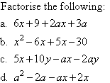

Slide 4

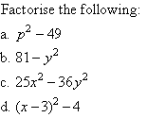
2.7 Factorisation of a Difference of Two Squares
Example:

Slide 5


Solution:
Do you know?
2.8 Taking out a Common Factor

Slide 6
2.9 Factorisation of Quadratic Trinomials
What is a quadratic trinomial?
-It has 3 terms: term, term, and an independent term
- a, b and c are constants, and
- Eg.
-The Distributive Law is used in reverse to factorise a quadratic trinomial, as illustrated below.

Slide 7


We notice that:
5, the coefficient of x, is the sum of 2 and 3.
6, the independent term, is the product of 2 and 3.

Slide 8

Note:
The product of two linear factors yields a quadratic trinomial; and the factors of a quadratic trinomial are linear factors.

Slide 9
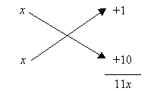
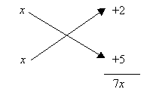
Cross-Multiplication Method

Slide 10

Factorise the following:

Slide 11
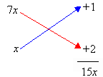
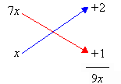

Further Quadratic Trinomials
Consider

Slide 12
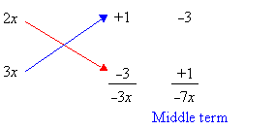
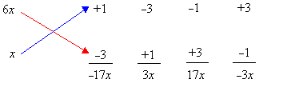

Use of a Common Factor
Example: Factorise
Take out common factor 2, we have,

Slide 13

2.10 Algebraic Fractions
We can write an algebraic fraction in the form
Algebraic fraction =
Proper and Improper Fraction
The fraction is proper, if
degree of the denominator > degree of the numerator
Eg.
The fraction is improper, if
degree of the denominator ≤ degree of the numerator
Eg. ,

Slide 14




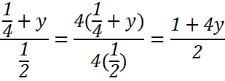
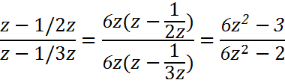
Example: Simplify (a) (b) (c)
Solution:
(a)
(b)
(c)

Slide 15




Addition of Algebraic Fractions
Example: Add
Solve the following:
(a) (b) (c)

Slide 16
2.11 Solving Quadratic Equations (by Factoring Method)
You may solve a quadratic equations using few ways,
Factorisation
Completed square form
Formula of

Slide 17
2.11 Solving Quadratic Equations (by Factoring Method)
Eg. Solve x² + 5x + 6 = 0
x² + 5x + 6 = 0
(x + 2)(x + 3) =0
x + 2 = 0 or x + 3 = 0
x = –2 or x = – 3 (Answer)

Slide 18
2.12 Solving Quadratic Equation (by Completing the Squares)
Some example of Completed Square form and Perfect Squares:
How to express in completed square form?

Slide 19
Eg. Express the following in completed square form

Slide 20
Eg. Express the following in completed square form

Slide 21
.
Example: Solve the quadratic equation

Slide 22
.
Example: Solve the quadratic equation
No solution for real values of x.

Slide 23
.
Try the following quadratic equations:

Slide 24
2.11 Solving Quadratic Equations (by Formulae)
Find out: How does this formula formed?
From the discriminant , the quadratic equation has
One real root/repeated roots if
two real roots if
(iii) no real roots if

