Slide 1
Algebra and Indices

Slide 2
Introduction
A binomial is an algebra expression containing 2 terms. For example, (x + y) is a binomial.
We know that
For higher powers, the expansion gets very tedious. Hence, the binomial theorem gives us the expansion for any positive integer power of (x + y)

Slide 3
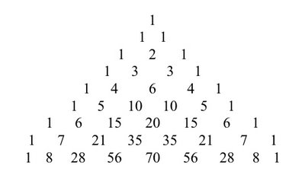
Pascal Triangle

Slide 4
Binomial Theorem
For any positive integer n,
where
In summation notation,
The (r + 1)^{th} term is

Slide 5
Binomial Theorem (cont)
A useful special case of the Binomial theorem is
for any positive integer n.

Slide 6
Binomial Theorem (cont)
Example 1: use the Binomial theorem to expand the following expressions.
(x + y)⁵
(1 – x²)⁴
(1 – 1/x)¹⁰
(2 – 3x)⁸

Slide 7
Binomial Series
The formula of (1 + x)^{n} can be extended to all real powers, i.e.
This expansion is valid for any real number n if |x|< 1.
Important notes:
Binomial theorem deals with a finite expansion,
i.e. n is a positive integer
B. It cannot use the button for the binomial series. It applies only to power of positive integer.

Slide 8
Binomial Series (cont)
Example 2: Use the binomial series formula to find the first four terms of the following expansion.
(1 + x)^{1/2}
(4 + x²)^{1/2}
(1 – 2x)⁻¹
(2 – x)⁻²

