Slide 1
ELECTRICAL MACHINES

Slide 2
Types of Electrical Machines.
DC MACHINES
Shunt, series, separately and compound excited,
Brush PM
INDUCTION (ASYNCHRONOUS) MACHINES
Capacitor start (single phase, squirrel cage)
Shaded-pole (single phase, squirrel cage)
3 phase squirrel-cage
3 phase wound-rotor (or slip-ring)
SYNCHRONOUS MACHINES
3 phase conventional excitation
3 phase Brushless Permanent (PM) Magnet
SPECIAL ELECTRICAL MOTORS
Reluctance motors, Stepper motor, Universal motors……

Slide 3
How they work
Two electromagnetic conversion phenomena:
Induced voltage: when a conductor moves in a magnetic field, voltage is induced in the conductor. (Generator action)
Force and developed torque: when a current-carrying conductor is placed in a magnetic field, the conductor experiences a mechanical force. (Motor action)

Slide 4
Rotating Electrical Machines
Fixed stator: This (normally) sets up magnetic field.
Rotating rotor: This (normally) carries currents (either supplied from a power source or (induced).
Stator
F
l
l
r
Rotor
B
B
Current (I) flows in rotor.
Force on conductor: F=IBl
Torque: T=Fr
Stator sets up B field

Slide 5
Rotor rotates (anticlockwise)
1/4 revolution later we have
For a particular machine:
  How B is produced?
  How do we get currents in rotor to produce continuous torque?

Slide 6
Principle of Operation of DC Motors
I_{f}
B
Field winding (2 coils in series as shown) carries field current I_{f}
I_{f} sets up magnetic field shape as shown

Slide 7
F
B
F
Brush
i
i_{a}
i_{a}
F
B
B
Rotor carries “armature” winding.
Armature current i_{a} fed to through commutator and brushes.
This feeds i_{a} to different windings as rotor rotates. Result is that the current distribution in space is fixed.
Force = i_{a}B.l always in direction shown since current distribution is fixed in space.
Torque = Force x radius
Torque = i_{a} B.l r

Slide 8
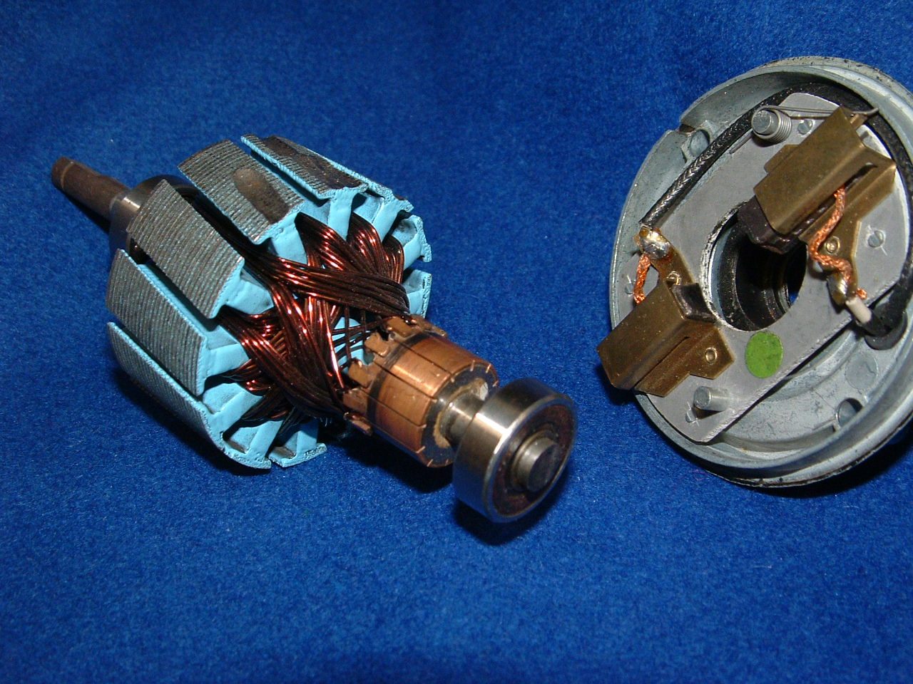
Permanent Magnet DC Motor
Magnetic Core
Armature windings
Commutators
Brushes

Slide 9
1. Force on conductor carrying I in field B
F
F
F = I B l
l = length of conductor in field
B
B
i
i
2. Voltage (emf) induced in conductor traveling in field B
B
v
e =ν B l
e = voltage induced along length l
v
B
e
e

Slide 10
  e induced in each conductor
  N conductors are all in series
  Therefore total "back-emf " induced
in armature winding is E = Ne
  E = Nν B l
ν = ωr (ω = angular velocity, rad/s)
E = Nωr Bl = kω
  E is proportional to ω
ν
F
ω
i_{a}
F
ν
E
R_{a}
i_{a}
i_{f}
R_{f}
Equivalent circuit of a separately excited DC motor
V_{a}
E
V_{f}
T, ω

Slide 11
Cross section of a permanent magnet DC motor
Stator
Direction of B
Winding Axis of Rotor
Note it is perpendicular to the magnet flux
Rotor with Commutator and End Frame with Brushes of Simple Permanent Magnet Machine

Slide 12
Characteristics of DC Machine
I_{f} sets field B. This normally constant
Torque = k i_{f} i_{a}. If i_{a} supplied form separate supply then i_{a} controls torque. (If we want more torque then we inject more i_{a})
Carbon brushes required – sparking is common and brushes wear out – regular maintenance
Quite expensive due to commutator and armature winding construction.
Very common for small motors (tape recorders, CDs, drills, printers, photocopiers etc. In these cases, B is often supplied by a permanent magnet.
Can put armature and field winding in series and run it directly off single phase household mains. This called a “universal motor”. Used in lawn mowers, washing machines, cheap tools, hairdryers etc.

Slide 13
Torque in Universal Motor
The single phase Universal Motor is very similar to a DC series motor. It can operate on either AC or DC and the resulting torque is about the same in each case. That is why it is called Universal Motor
i_{a} = i_{f} maximum positive
i_{a} = i_{f}
F
i_{a}
B

Slide 14
I_{f} = 0
i_{a} = i_{f}
i_{a} = 0
i_{a} = i_{f} zero
B
i_{a} = i_{f}
F
i_{a}
i_{a} = i_{f} maximum negative
Torque
Torque is pulsating

Slide 15
Characteristics of Universal Motor
Normally Universal motors are rated at fractional horse power (less than 1kW)
The main advantage of Universal motors is their high speed ( 1500 to 15000rpm) and high starting torque
Therefore, they are used to drive high speed centrifugal blowers in vacuum cleaners
The high speed and corresponding small size for a given power output is also an advantage in driving portable tools, such as electric saws and drilles

Slide 16
THE 3-PHASE INDUCTION MACHINE
≈ 65% of world's generated energy → rotating machines
>90% of this → induction machines
Induction motor construction:
The induction motor comprises two parts:
outer stationary frame called the “stator”
inner rotating section known as the “rotor”
The stator has a large number of circular silicon steel laminations with slots cut in their inner circumference mounted in a fabricated or cast steel frame. Three phase windings mutually displaced by 120° in space are wound in the slots.

Slide 17
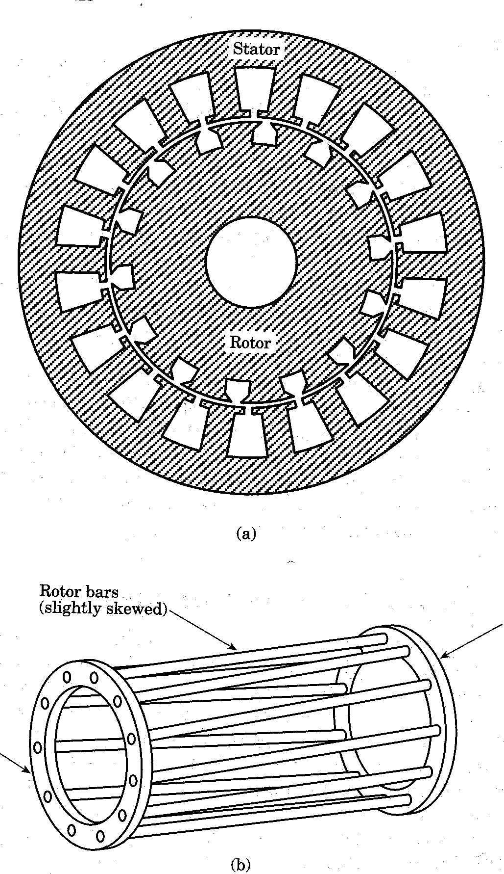
Constructions and Types
The two principal parts of the motor are the rotor and the stator.
Stator construction
  Laminated iron core with slots
  Coils are placed in the slots to form a three or single phase winding
Squirrel-cage rotor construction
  Laminated Iron core with slots
  Metal bars are molded in the slots
  Two rings short circuits the bars
  The bars are slanted to reduce noise and harmonics

Slide 18
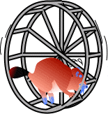
Constructions and Types
The two principal parts of the motor are the rotor and the stator.
Stator construction
  Laminated iron core with slots
  Coils are placed in the slots to form a three or single phase winding
Squirrel-cage rotor construction
  Laminated Iron core with slots
  Metal bars are molded in the slots
  Two rings short circuits the bars
  The bars are slanted to reduce noise and harmonics

Slide 19
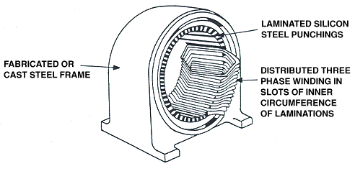
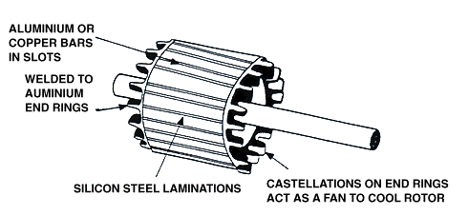
Stator
The most common form of rotor known as the “squirrel cage rotor” It has silicon steel laminations keyed to a central shaft. Slots in the laminations at or close to the outer circumference, carry aluminium or copper conductors. The ends of the conductors are welded to aluminium end rings, which are sometimes castellated to facilitate cooling during operation
Rotor

Slide 20
Rotor
(side view)
Iron
End rings
Al bars
Power Range
200-500W small fans
1-50kW fans, pumps, conveyors, escalators
50-500kW water pumping, coal cutting,
1MW high speed train motor (eg. x4)
10MW warship/cruise liner motor (x2)

Slide 21
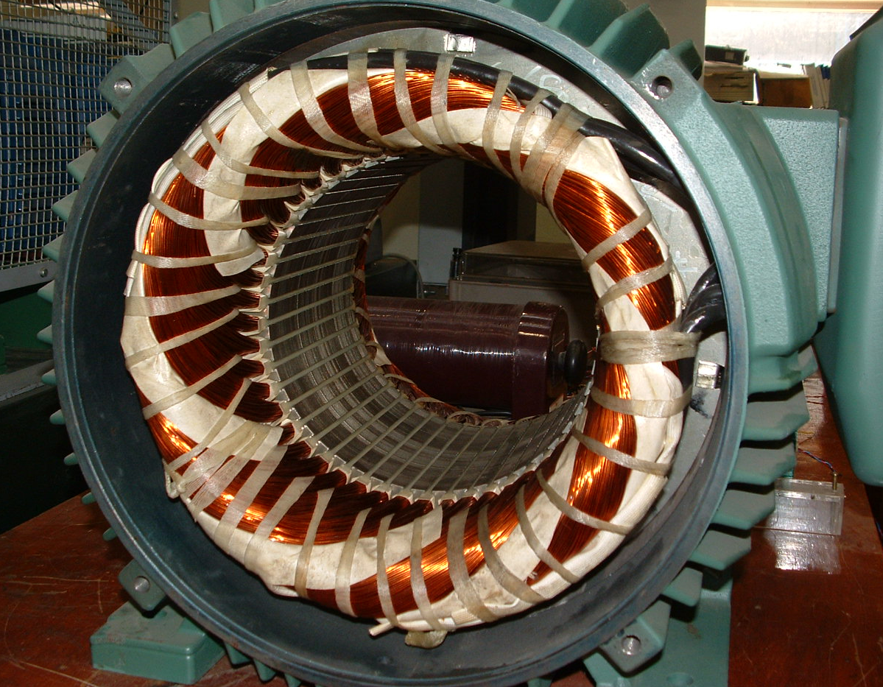
3 Phase Stator Winding

Slide 22
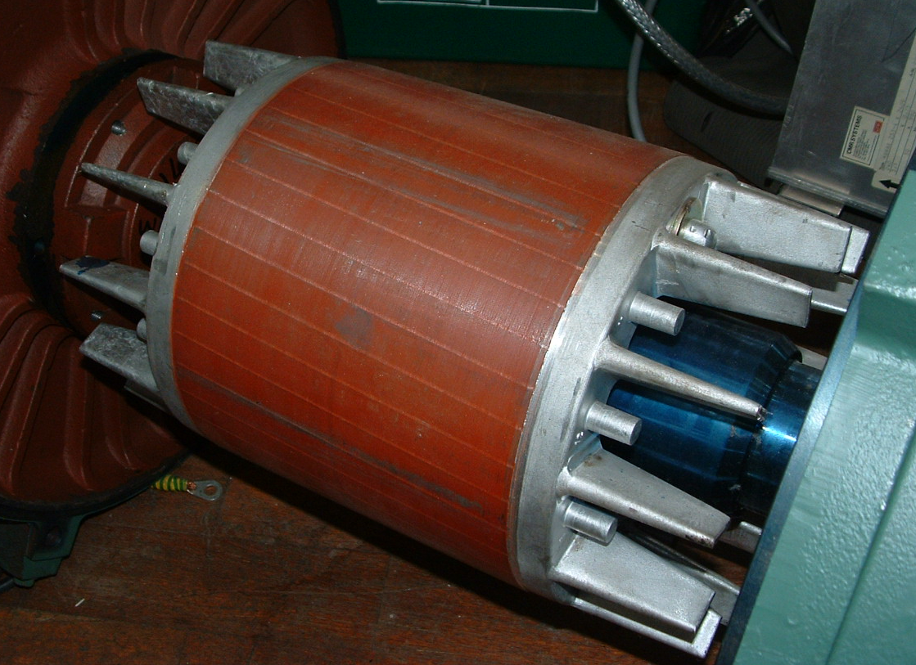
Rotor Showing Single Bars Short Circuited by ‘End Rings’

Slide 23
How Magnetic Field B is Produced
Principle of rotating field set up by 3-phase windings
A
A
×
C’
B’
C’
B’
B
B
C
C
A’
A’
3 phase windings on stator
Representation of 3φ stator windings
A
B’
C’
B
C
A'
Field due to AA’ winding
Due to BB’ winding
Due to CC’ winding

Slide 24
Red vector is voltage (or current or flux) due to phase A
Blue/Green vector for phase B and C respectively
Initial
time t₀
t₁>t₀
t₂>t₁
t₃>t₂
t₄>t₃
Add blue and red together
Initial
time t₀
t₁>t₀
t₂>t₁
t₃>t₂
t₄>t₃
Now, add in green vector
Initial
time t₀
t₁>t₀
t₂>t₁
t₃>t₂
t₄>t₃
Note resultant is 1.5 times peak of phase vector

Slide 25
The Currents in AA’, BB’, CC’ are 120° apart in time. Result is a 2-pole field distribution that rotates in space at a rotational speed ω_{s} = ω_{e} = 2πf mechanical radians/sec
N
S
If the windings as in figure below, the result is a 4-pole field distribution (below right) that rotates at a rotational speed ω_{s} = ω_{e}/2 = πf mechanical radians/sec
A
N
C’
B’
B
C
S
A’
A
C
B
S
B’
C’
N
A’

Slide 26
How Magnetic Field B is Produced
Electrical frequency is elec. rads/s
B rotates in space at mech. rads/s
is called the synchronous speed. Or n_{s}=120f/P in rpm
The greater no. of poles, the slower the synchronous speed
f_{e} | ω_{e} =2πf_{e} | P | ω_{s} (rad/s) | n_{s} (rpm)
50 | 314 | 2 | 314 | 3000
50 | 314 | 4 | 157 | 1500
50 | 314 | 6 | 105 | 1000
50 | 314 | 8 | 78 | 750
50 | 314 | 10 | 63 | 600

Slide 27
1 rpm = 2π radians/minute = 2π/60 radian/second (rads-1)
Therefore 1 rads⁻¹ = 60/2π ≈ 10 rpm
Stator windings of an Induction Machine (IM) can only be wound in one way. P is fixed for an individual machine. An IM can either be a 2-pole machine, or a 4-pole machine or ….etc

Slide 28
Torque Production in an Induction Motor
B
B
B
ω_{S}
v =ω_{Sl} r
v =ω_{Sl} r
e = Blv
I = Blv/R_{bar}
B goes round at ω_{S}
Rotor goes round at ω_{r}
Rotor sees B go round at ω_{sl} = ω_{S} - ω_{r}
B goes past bars at v =ω_{sl} r
r = radius of rotor
l = length of rotor bars
Emf (voltage) INDUCED
in bars is:
e = Blv = Blω_{sl} r
Hence currents flow in bars is:
I = Blv/R_{bar}
I = Blω_{sl} r/R_{bar}
I ∝ ω_{sl}
ω_{s} : magnetic field speed
ω_{r} : Rotor speed
ω_{sl} : Slip speed

Slide 29
B
B
B
F
F=BIl
F
I = Blv/R_{bar}
B “arrow” is where B is max.
I_{r} distribution is as above.
Maximum current is where max B is.
Induced current distribution goes round with B.
Rotor sees current pattern go round at ω_{sl} = ω_{S} - ω_{r}
Force will act as above
(Force shown on 2 currents only)
T = Torque = Fr
T ∝ B I l, I ∝ ω_{sl}
T ∝ ω_{sl}
Force acts on current flowing in B
F= B I l
F is continuous since
B and I distribution go round together.
Torque causes rotor to rotate at ω_{r}
Steady state speed reached when T balances mechanical load (eg. friction etc)
If rotor catches up with B, then T must be zero since ω_{sl} = ω_{S} - ω_{r} is zero

Slide 30
Rotor Currents, Slip and Torque
B goes past rotor conductors at synchronous speed ω_{s}
Rotor conductors see changing field (like changing flux in TF)
Hence currents induced in the rotor bars (like I induced in TF secondary)
Currents will react with B to give a torque
Rotor will rotate and tries to catch up with B
If catches up, ω_{r} = ω_{s} , now rotor sees stationary B (or flux). Hence T = 0
Bigger difference in ω_{s} - ω_{r} ( = ω_{slip} ), greater rotor currents, greater T
In fact, T ∝ ω_{slip}. Let's plot Torque against rotor speed:

Slide 31
T
T_{rated}
ω_{rated}
ω_{r}
S=1
ω_{s}
S=0
ω_{slip}
ω_{slip_rated}
All IM's have:
T_{rated}: Rated continuous torque
(lf more, I_{r} will be too high, rotor will become too hot)
ω_{r} rated: Rated speed of 4 pole motor e.g. 1460 rpm
Rated speed of 6 pole motor e.g. 940rpm
ω_{slip} rated ω_{s} - ω_{r} _{rated} in either rpm or mechanical rads-1
Normalised slip usually in % (should be small!)
As ω_{r} goes from ω_{s} to zero, s goes from 0 to 1

Slide 32
Maximum Torque and Starting Torque
Complete rest of T-speed curve (just accept this)
Also plot I_{stator} (written I_{s})
- as slip increase, I_{r} increases
- I_{r} sets up (rotating) field of its own to try and reduce main B
- Not allowed to do this! See TF operation!
- Additional I_{s} flows to nullify field of I_{r}

Slide 33
Pull out torque
I_{Stator}
I_{Stator}
T
Starting torque
T_{rated}
P
Load
ω_{r}
ω_{s}
s
Can start IM by switching onto 3φ mains (DOL start)
Pull out torque usually 2 to 3 x T_{rated}
T_{start} normally less than T_{pull out}
I_{s} at start can be very large, often 5 to 8 x I_{s_rated}
IM must accelerate quickly to point P so that large I_{s} flows only for a short time

Slide 34
Per-phase Equivalent Circuit
Look at one phase of IM. eg. Phase A
Let motor be connected to 50Hz mains, with no load.
In steady state ω_{r} ≈ ω_{s}
No rotor currents
I_{s} = I_{o} , current to set up B called no-load current
I_{s}
I_{o}
V_{S}
L_{o}

Slide 35
Per-phase Equivalent Circuit
Now load up machine:
Slows down by ω_{slip} and I_{r} starts to flow
An extra I_{s} flows to cancel field of the rotor current, since B is determined by the applied voltage
Equivalent circuit like TF:
I_{s}
I_{r}'
l_{r}
I_{r}
I_{m}
R_{r}
V_{s}
L_{o}
N_{s} : N_{r}

Slide 36
N_{s} : N_{r} unknown (no rotor coils to compare stator coils with)
R_{r} is unknown
I_{r} is unknown (in rotor bars - never come out into outside world)
But I_{r}' is the extra stator current that flows under load
Since everything about real rotor is "unknown", makes sense to refer it to the stator side.
Passing the rotor parameters through the ideal TF we get:
l_{r}'
I_{s}
I_{r}'
I_{o}
V_{s}
R_{r}' / s
L_{o}

Slide 37
Note R_{r} becomes R_{r} /s (just accept this now). For more details see the handout on Induction motor equivalent circuit.
When s = 0 , R_{r} /s = ∞ , I_{r} = 0
Unlike TF, I_{r} never seen. We will drop the ' from now on.
I_{r} used to denote extra stator current when IM is loaded.
There is one circuit for each phase. But V_{s} and I_{s} etc… in Phases B and C will lag 120° and 240° behind Phase A.
For analysis, only necessary to consider one phase cct.
Machine may be connected in star or delta: see next slide

Slide 38
I_{L}
I_{L}
I_{s}
V_{s}
I_{s}
V_{s}
V_{L}
V_{L}
It is V_{s} and I_{s} that are used in the equivalent circuit
But IMs have a rated stator voltage and current – these are always V_{L} and I_{L} !
e.g. A Δ connected IM is rated at 415V, 25A.
Hence V_{s_rated} = 415V, I_{s_rated} = 25/√3

Slide 39
Effect of Rotor Leakage Inductance
B
B
v =ω_{S}r
v =ω_{S}r
e = Blv
I ≠ Blv/R_{bar}
Emf (voltage) INDUCED
in bars
e = Blv = Blω_{sl} r
This is same as before
Maximum e induced in bars where B is maximum.
But currents in bars no longer I = Blv/R_{bar} because rotor bars now exhibit inductance due to leakage l_{r}
Currents will lag (in time) the induced voltage e.

Slide 40
B
θ
F
B
F
The effect is that the current distribution appears to lag the field.
The maximum current no longer occurs at the maximum B
The force F is now F = BIlcosθ
(Force shown on 2 currents only)
The torque is now T ∝ BIl cosθ
It has been reduced.
  In practice, it is found that as the real bar currents increase, the leakage increases and θ gets larger and larger. Eventually, this causes the torque to reduce.
  The effect explains why the torque-speed curve starts to bend away from a straight line and why there is a pull-out torque.

Slide 41
Power Flows and Motor Torque
Can split the term into
X_{r} =ω_{e} l_{r}
R_{r}
I_{s}
I_{r}
ω_{e} = 2πf_{e} = 314
I_{o}
P_{heat}
V_{s}
R_{r}(1-s)
s
L_{o}
P_{mech}
Power transferred across the air gap splits into two:
P_{air gap} = Power lost as heat in bars + Mechanical Power
P_{air gap} = P_{heat} + P_{mech} ie:

Slide 42
Note the "3" because we have 3 phases
means the square of the rms (phasor) value
P_{mech} = Torque x angular rotor speed
P_{mech} = Tω_{r}
Now
∴

Slide 43
And you see that the ω_{r} terms cancel. It is convenient to replace ω_{s} with the electrical frequency ω_{e} . Remember that:
Hence:
I_{r} is the extra stator current flowing when a load is applied (ie. the rotor slips). It is better to have the expression in terms of the applied stator voltage Vs.
From circuit diagram, we can calculate I_{r} in terms of V_{s}. We are in steady state AC, therefore we should use phasors:

Slide 44
Original circuit:
I_{s}
I_{r}
X_{r} =jω_{e} l_{r}
R_{r}
V_{s}
V_{s}
X_{r} =jω_{e} l_{r}
I_{r}
I_{r}
R_{r} / s
V_{s}
V_{s}
Where
and

Slide 45
Hence:
and
This expression has only one variable – s!
Therefore plotting the expression against s: see next slide

Slide 46
T
T_{max}
ω_{r}
ω_{s}
s
By putting can show that T_{max} occurs at
In operating region, neglect X_{r}

Slide 47
and we see that T ∝ s
For reference, T_{start} obtained from putting s = 1 in Full
expression:

Slide 48
Induction Motor Equivalent Circuit - Example
A 3-phase Cage Rotor Induction Motor with 2 pole-pairs is connected in delta and is fed from a 415V, 50Hz supply. The machine is mechanically loaded so that it runs at a slip of 2%. The parameters of the machine referred to the stator are: Rotor Resistance 0.2Ω and Rotor Leakage Inductance = 10mH. The stator resistance, stator leakage inductance and the iron losses may be neglected. Determine:
i. The speed of the rotating field in rpm. [1500rpm]
ii. The rotor speed in rpm.[1470rpm]
iii. The magnitude of rotor current per-phase referred to the stator. [39.6A]
iv. The total power input to the rotor. [47.045kW]
v. The power lost as heat in the rotor. [941W]
vi. The torque produced by the machine. [299Nm]

Slide 49
EXERCISE: Slip
A three-phase 415 V (line-to-line voltage), 50 Hz induction motor runs at 1478 rpm. Determine the number of poles, the slip and the frequency of the rotor current.
SOLUTION:
Because the synchronous speed must be slightly higher than the running speed and because at 50 Hz the only possibility is 1500 rpm.
The induced emf in the rotor is due to the slip speed, and therefore
f_{rotor} = s x f = 0.015 x 50 Hz = 0.75 Hz

Slide 50
Examples
A 4 pole machine on a 50 Hz supply is running at a speed of 1440 rpm what is the slip?
A 10 pole machine operates at a speed of 700 rpm at a slip of 0.0278 what is the supply frequency?
A 50 Hz 4 pole machine is operating at a speed of 1560 rpm what is the slip?
A 6 pole machine operating from a 50 Hz supply has a slip of 1.96, what is the mechanical speed?
(a) 60 rpm (b) 4% (c) -0.04 (d) none of the above
(a) 980.4 rpm (b) 960 rpm (c) -960 rpm (d) none of the above

